Slide 1
Sant Gadge Baba Amravati University Ph. D. Coursework Module 2 ICT :
Ref: Tutorialspoint,Web

Slide 2
Syllabus
Introduction to
IT & ICT
OS
Word
Spreadsheet
Presentation
Internet

Slide 3
What is IT, ICT
IT stands for Information Technology.
This tech. is used to send, receive, process and store data.
It involves computer, software, networking and other infrastructures.
servers, security companies.
ICT stands for Information Communication Technology.
IT companies specializes on Information management
It emphasis on effective communication.
AV, Learning management System

Slide 4

Def: “Computer is an Electronic device that accepts data from user, process it and produces results.”

Slide 5
Characteristics of a Computer
Speed: A computer works with high speed and accuracy, about millions instructions per second.
Accuracy: Calculations performed are 100% accurate.
Versatility: Capable of performing different kind of works.
Reliable Engineering: Consistent result for similar set of data.
Storage: Built-in Memory is called primary memory to store data, secondary storage refers to hard-disk, removable storages.

Slide 6
Limitations of a Computer
A computer is a machine that has no intelligence to perform any task.
• Each instruction has to be given to the computer.
• A computer cannot take any decision on its own.

Slide 7
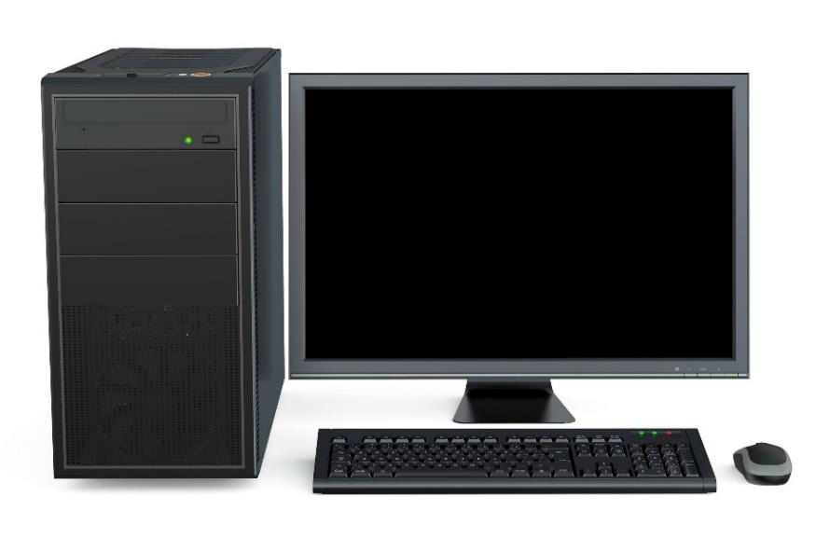
Types of Computers:
Desktop

Slide 8


Laptop
Tablet

Slide 9
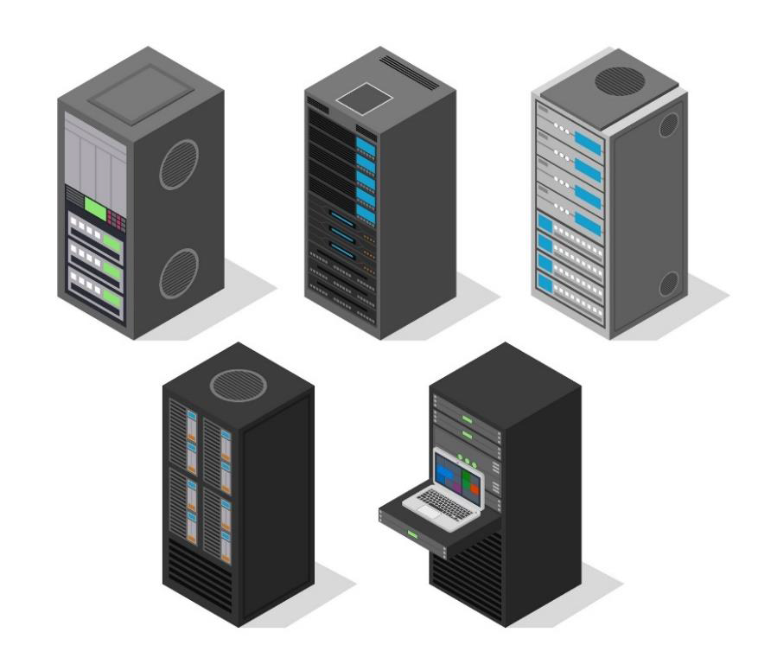
Server (Computer)

Slide 10
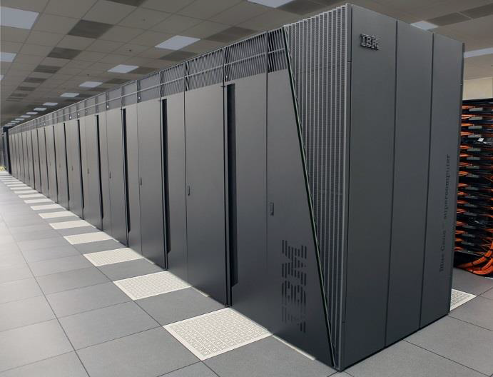
Super computer

Slide 11
Main parts of a Computer
CPU:
Storage/Memory Units:
I/O accessories:

Slide 12
Software:
A set of instructions that achieve a single outcome are called program or procedure. Many programs functioning together to do a task make a software.
There are two categories of software:
• System software
• Application software / Utility software

Slide 13
What is Internet, Intranet and Extranet
Internet: Its global collection of computer networks.
Intranet: online network for particular organization.
Extranet: Extension of intranet (with third parties)

Slide 14
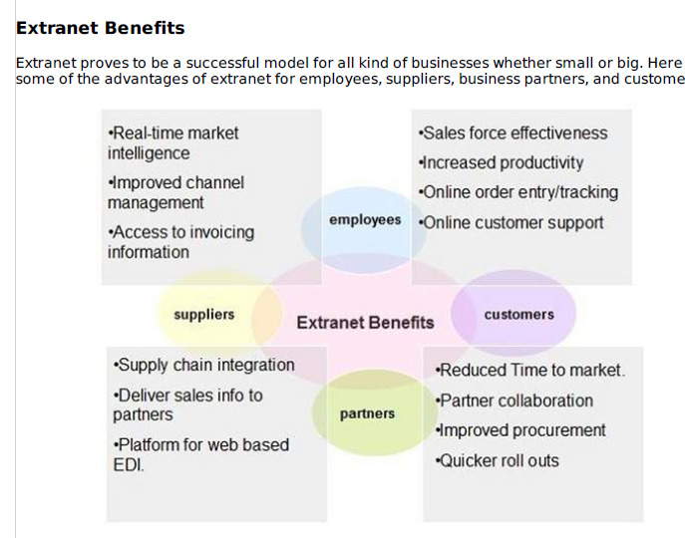

Slide 15
Operating System (OS):
An Operating System (OS) is an program that provides interface between a computer user and computer hardware. An operating system is a software which performs all the basic tasks like file management, memory management, process management, handling input and output, and controlling peripheral devices such as disk drives and printers.
Some popular Operating Systems include Linux Operating System, Windows Operating System, etc.

Slide 16
Following are some of important functions of an operating System.
• Memory Management
• Processor Management
• Device Management
• File Management
• Security
• Control over system performance
• Job accounting
• Error detecting aids
• Coordination between other software and users

Slide 17
File management system:
A file system is normally organized into directories for easy navigation and usage. These directories may contain files and other directions. Operating System provides following functions:
• Keeps track of information, location, uses, status etc. The collective facilities are often known as file system.
• Decides who gets the resources.
• Allocates the resources.
• De-allocates the resources.

Slide 18
Memory Management
Keeps tracks of primary memory, i.e., what part of it are in use by whom, what part are not in use.
• In multiprogramming, the OS decides which process will get memory when and how much.
• Allocates the memory when a process requests it to do so.
• De-allocates the memory when a process no longer needs it or has been terminated.

Slide 19
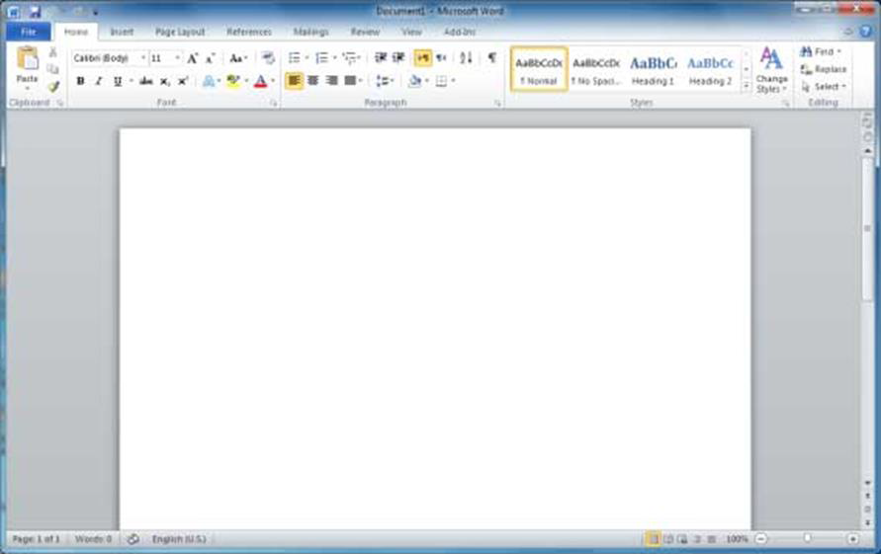
WORD

Slide 20
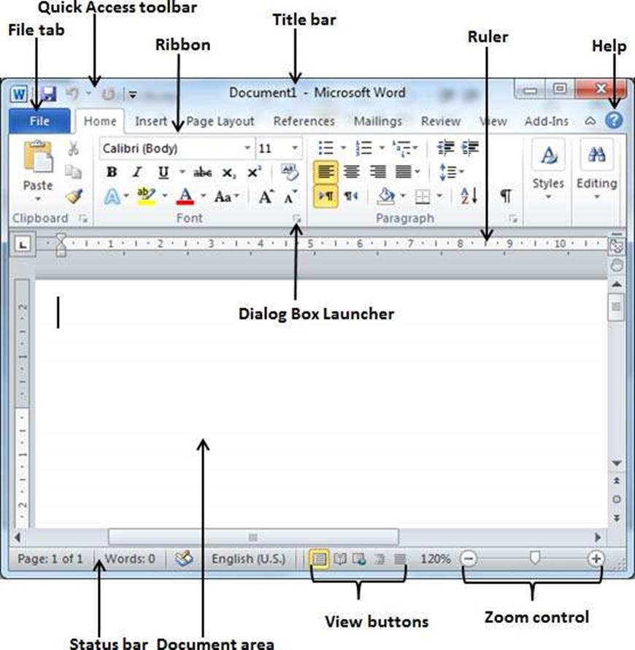

Slide 21
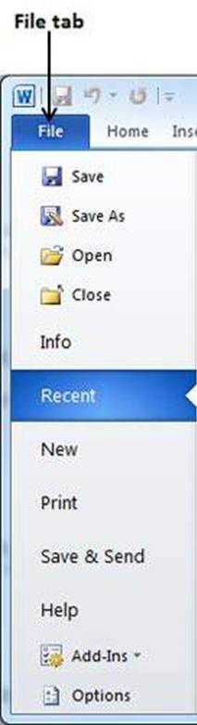
File Tab
The File tab replaces the Office button from Word 2007. You can click it to check the Backstage view. This is where you come when you need to open or save files, create new documents, print a document, and do other file-related operations.
Quick Access Toolbar
This you will find just above the File tab. This is a convenient resting place for the most-frequently used commands in Word. You can customize this toolbar based on your comfort.

Slide 22
Ribbon : Ribbon contains commands organized in three components:
Tabs: These appear across the top of the Ribbon and contain groups of related commands. Home, Insert, Page Layout are examples of ribbon tabs.
Groups: They organize related commands; each group name appears below the group on the Ribbon. For example, group of commands related to fonts or group of commands related to alignment, etc.

Slide 23
Commands: Commands appear within each group as mentioned above.
Title bar :This lies in the middle and at the top of the window. Title bar shows the program and document titles.
Rulers :Word has two rulers - a horizontal ruler and a vertical ruler. The horizontal ruler appears just beneath the Ribbon and is used to set margins and tab stops. The vertical ruler appears on the left edge of the Word window and is used to gauge the vertical position of elements on the page.

Slide 24
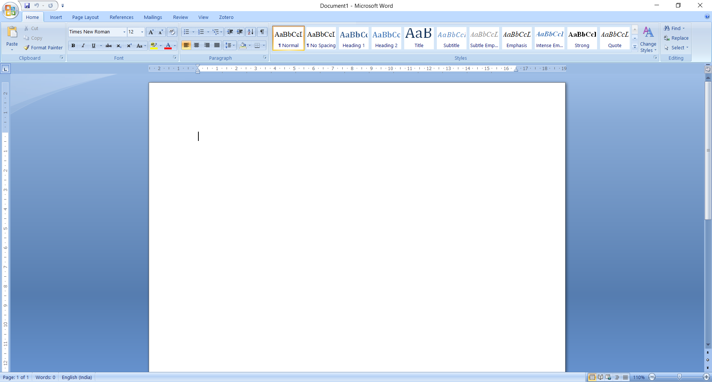
Paragraph formatting

Slide 25
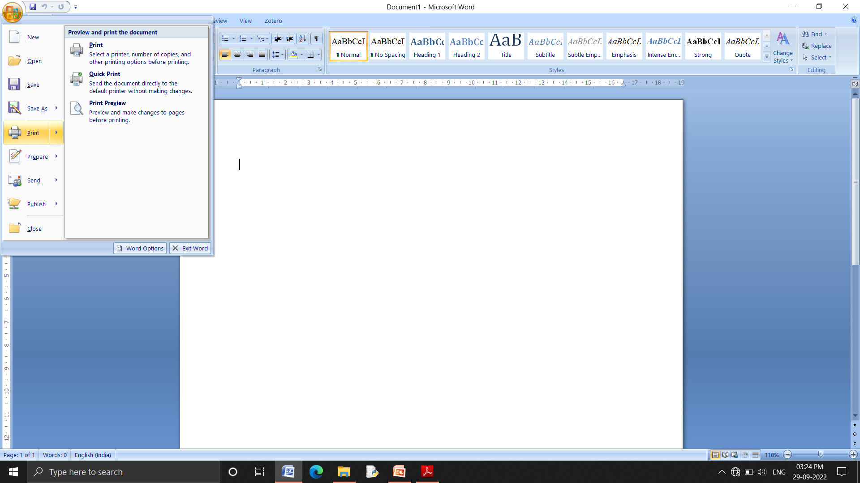
Print:

Slide 26
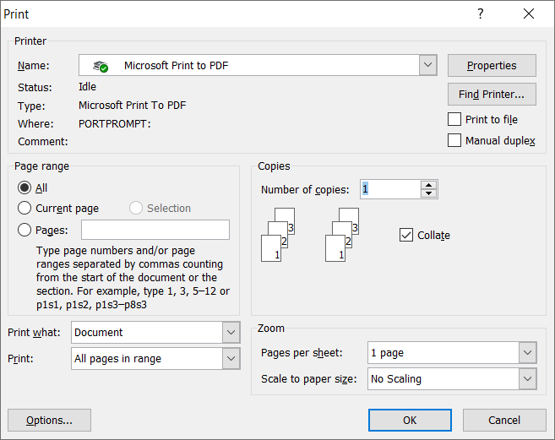

Slide 27
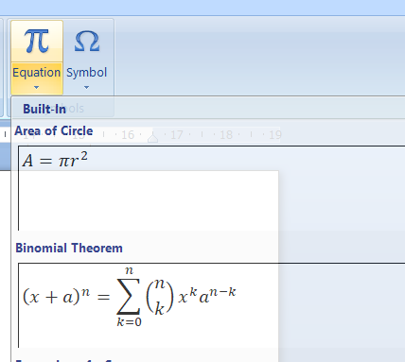
Insert:-> equation/symbols

Slide 28
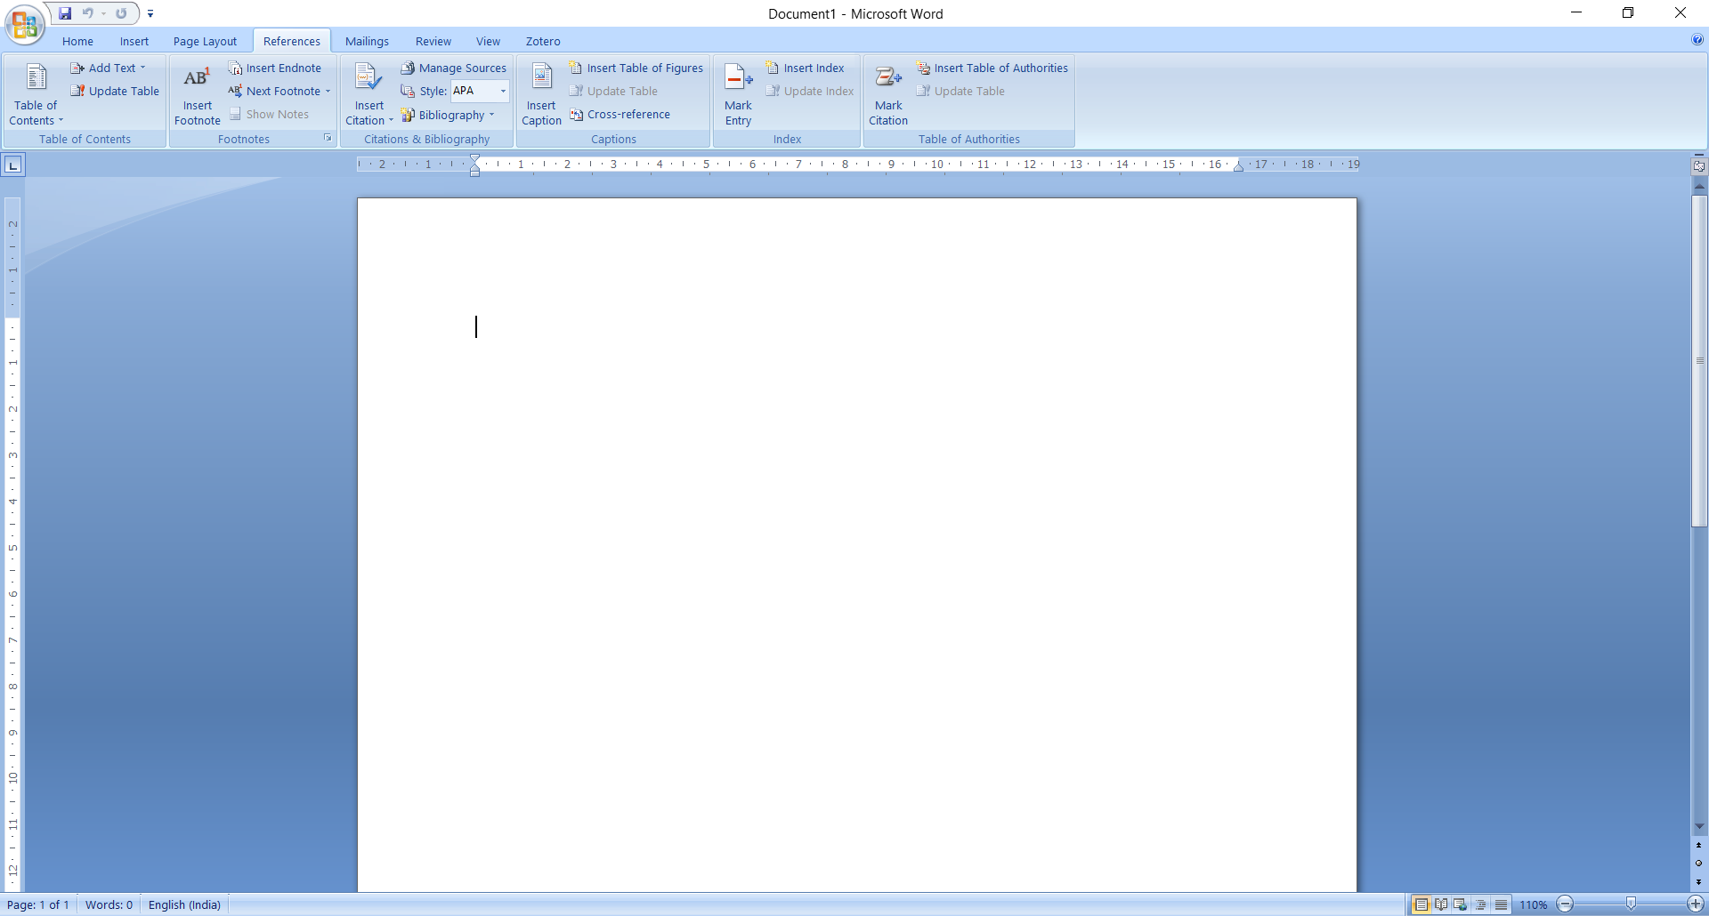
Referencing/Indexing tools

Slide 29
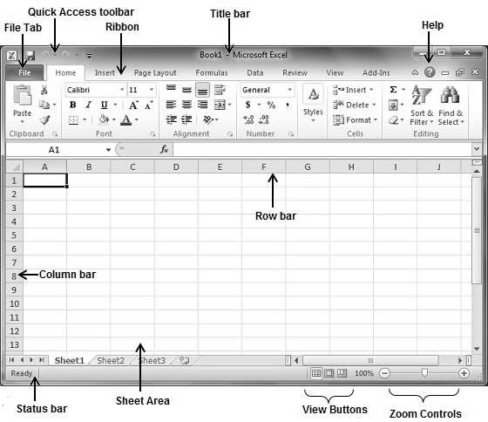
Spreadsheet:

Slide 30
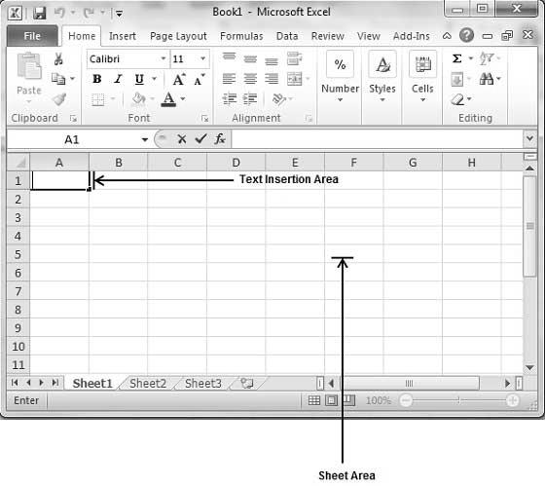
Inserting Values

Slide 31
Navigations
There are following three important points, which would help you while typing:
• Press Tab to go to next column.
• Press Enter to go to next row.
• Press Alt + Enter to enter a new line in the same column

Slide 32
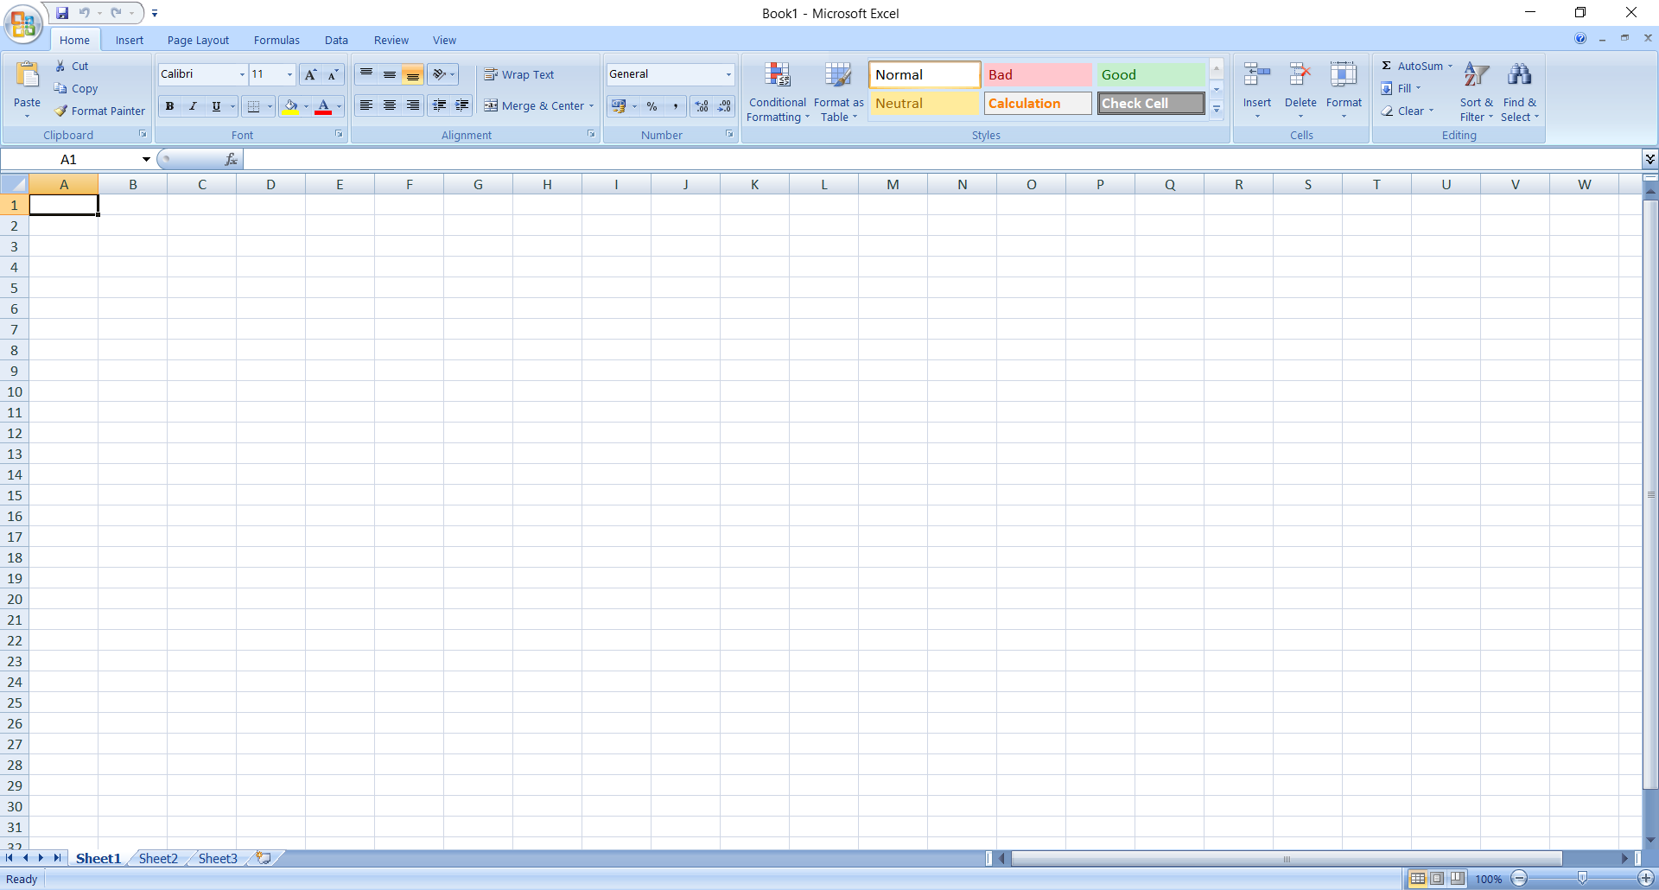
Functions:

Slide 33
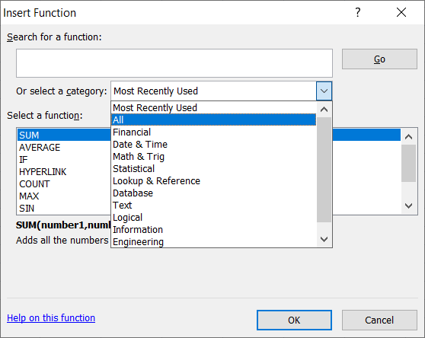
Inserting Function:

Slide 34
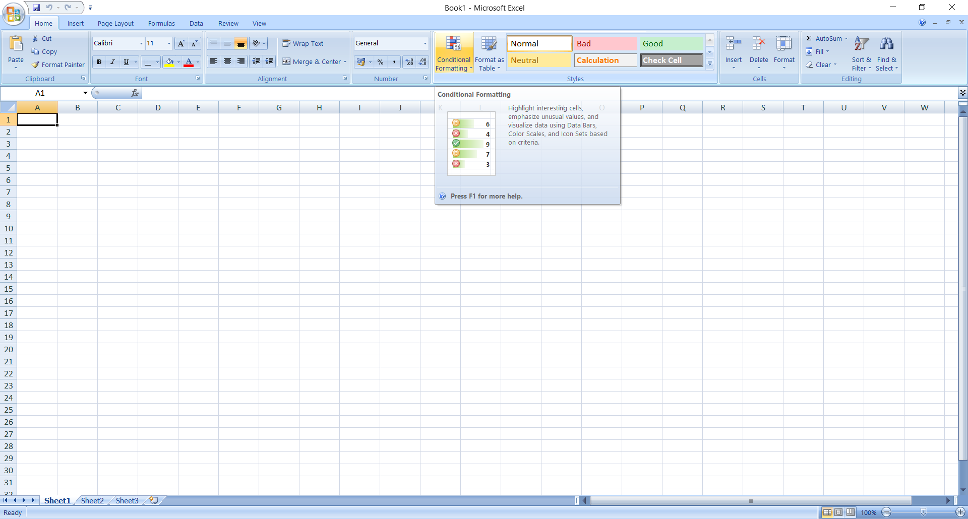
Formatting Cells:

Slide 35
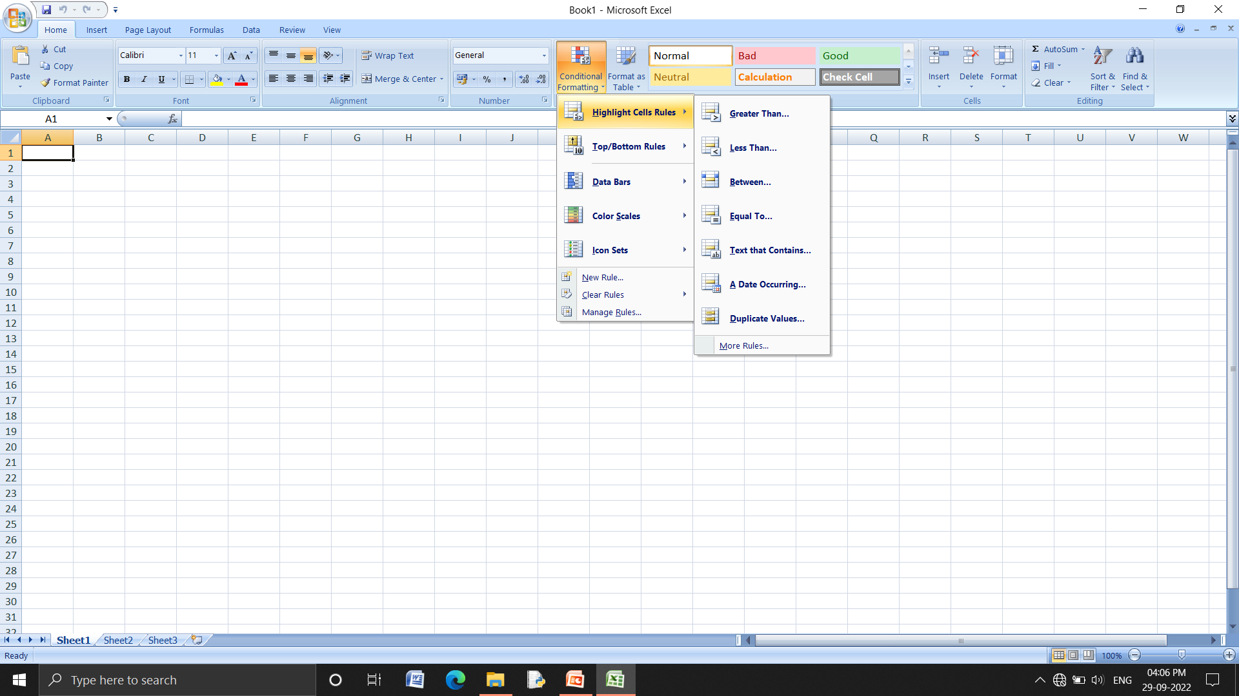
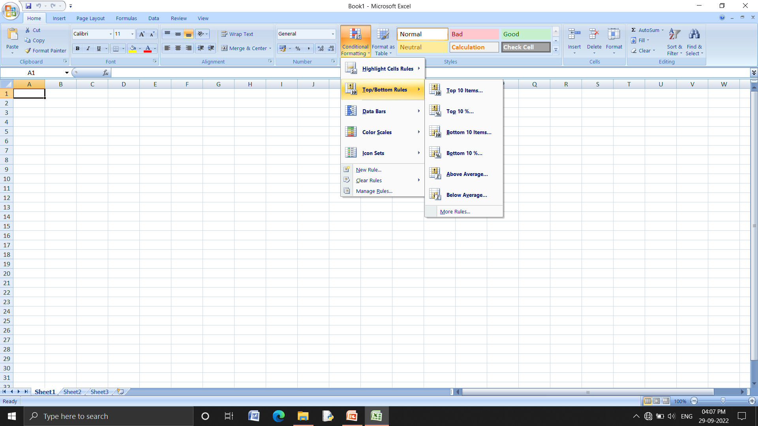

Slide 36
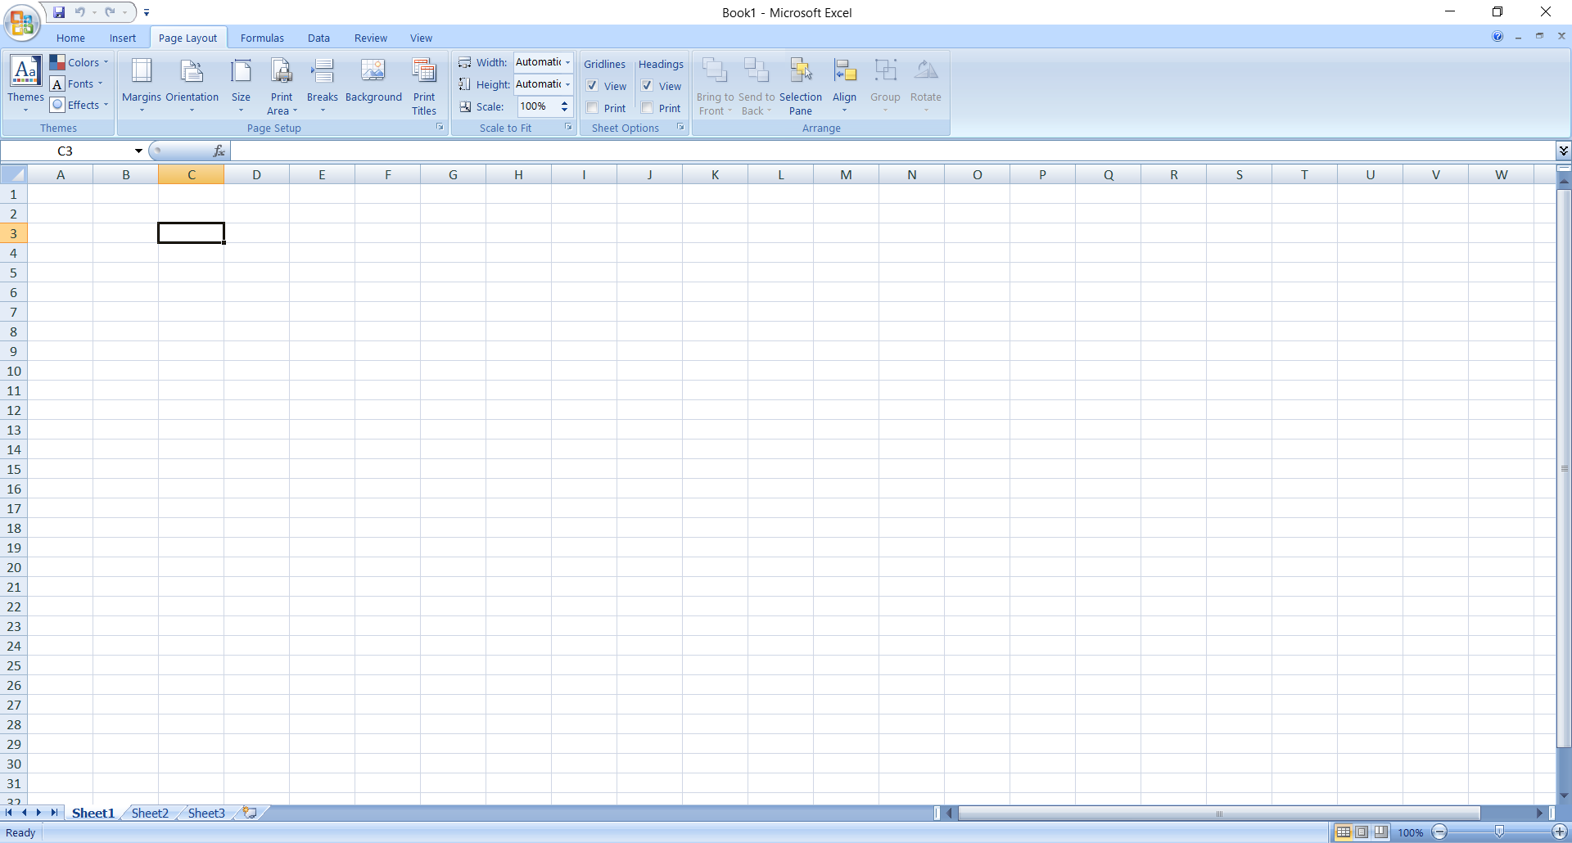
Setting Page layout :

Slide 37
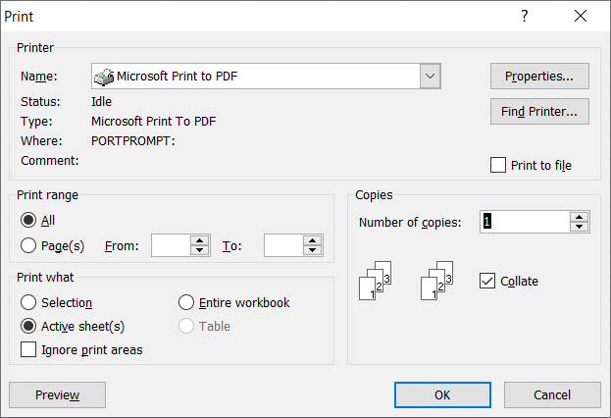
Printing Spreadsheet

Slide 38
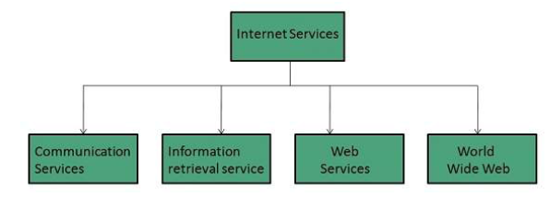
Introduction to Internet:
Internet Services allows us to access huge amount of information such as text, graphics, sound
and software over the internet. Following diagram shows the four different categories of Internet Services.

Slide 39
Electronic Mail
Used to send electronic message over the internet.
Email Service provider: Google-Gmail, Yahoo-Yahoo-mail, Rediff-mail.

Slide 40
Web Services:
World Wide Web WWW
WWW is also known as W3. It offers a way to access documents spread over the several servers
over the internet. These documents may contain texts, graphics, audio, video, hyperlinks. The
hyperlinks allow the users to navigate between the documents.

Slide 41
Web Browser
web Browser is an application software that allows us to view and explore information on the
web. User can request for any web page by just entering a URL into address bar.
Web browser can show text, audio, video, animation and more. It is the responsibility of a web
browser to interpret text and commands contained in the web page

Slide 42
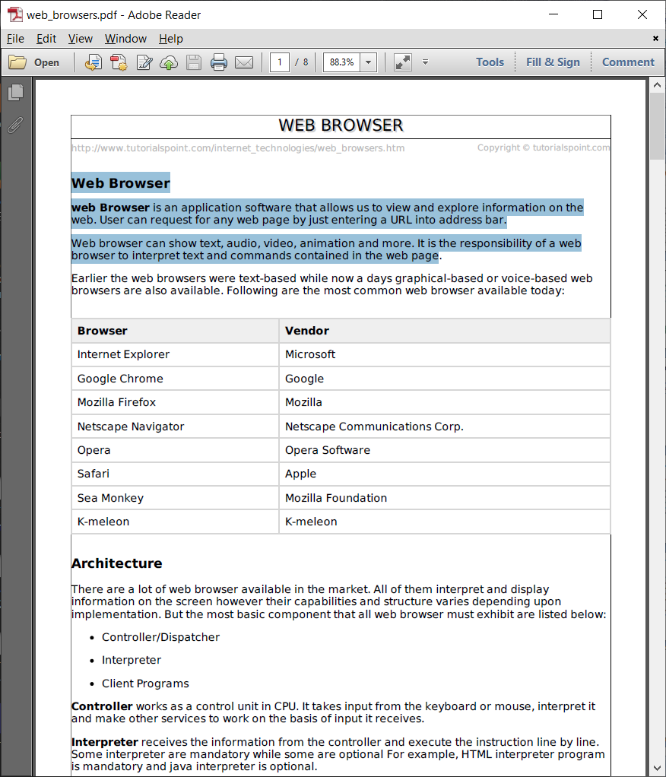
Some browsers:

Slide 43
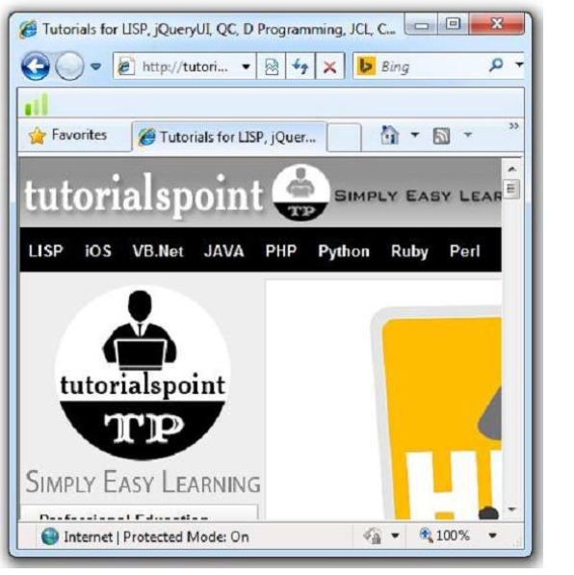
Internet Explorer:

Slide 44
E-Government:
India’s experience in E-Governance / ICT initiatives has demonstrated significant success in improving
accessibility, cutting down costs, reducing corruption, extending help and increased access to un-served
groups. In this phase of experimentation, many e-initiatives have reached millions of people belonging to
these sections of society. Improved access to information and services has provided economic and social
development opportunities, facilitated participation and communication in policy and decision-making
processes and empowerment of the weakest groups.

Slide 45
e-Government
e-Government is not simply a matter of giving government officials computers or automating old practices.
Neither the use of computers nor the automation of complex procedures can bring about greater
effectiveness in government or promote civic participation. Focusing solely on technological solutions will
not change the mentality of bureaucrats who view the citizen as neither a customer of government nor a
participant in decision-making.

Slide 46
E-Government
Simple;
Moral;
Accountable;
Responsive;
Transparent;

Slide 47
E-Learning:
E-learning has developed as a superior contrasting
option to conventional method of teaching. Traditional
teaching is based either on inside the classrooms or outside the
classrooms, whereas, e-learning exploits computers and the
internet. People can learn anytime and anywhere with the help
of e-learning. It includes training, delivery of information and
guidance from (subject) experts. It is also flexible and has no
time limits.

Slide 48
E-Commerce:
E-commerce as a transaction of
buying or selling online. Electronic commerce is the
expansion of e-commerce. E-commerce exploits technologies
such as mobile commerce, electronic funds transfer, supply-chain management, internet marketing, online transaction, etc.

